Slide 1
Systems and Scale Unit Activity 4.5: Explaining Ethanol Burning
Carbon: Transformations in Matter and Energy
Environmental Literacy Project Michigan State University
Notes:
Image Credit: Craig Douglas, Michigan State University

Slide 2
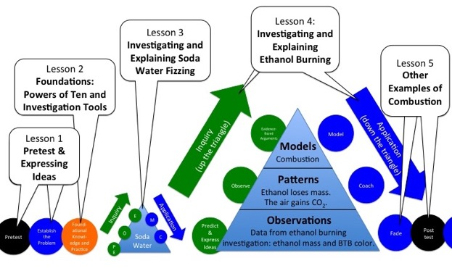
Unit Map
You are here
Notes:
Use the instructional model to show students where they are in the course of the unit.
Show slide 2 of the 4.1 Predictions about Ethanol Burning PPT.

Slide 3
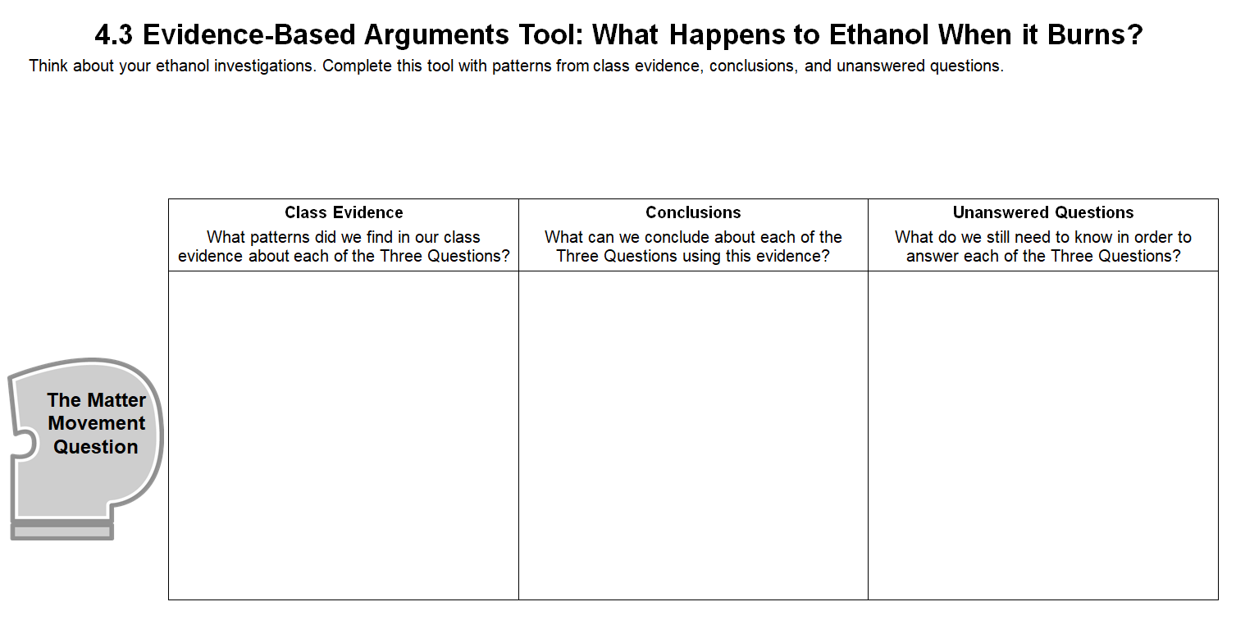
Revisit your arguments
Think about what you know now that you didn’t know before. What have you learned?
Notes:
Revisit students’ arguments about what happens to ethanol when it burns.
Show slide 3 of the Grading the Explanations Tool for Ethanol Burning PPT.
Tell students that this activity’s purpose is to develop explanations for what happens when ethanol burns.
Return each student’s copy of 4.3 Evidence-Based Arguments Tool for Ethanol Burning and have them review their arguments before they completed the molecular modeling activity.
Ask them to think about what they know now that they didn’t know then.

Slide 4
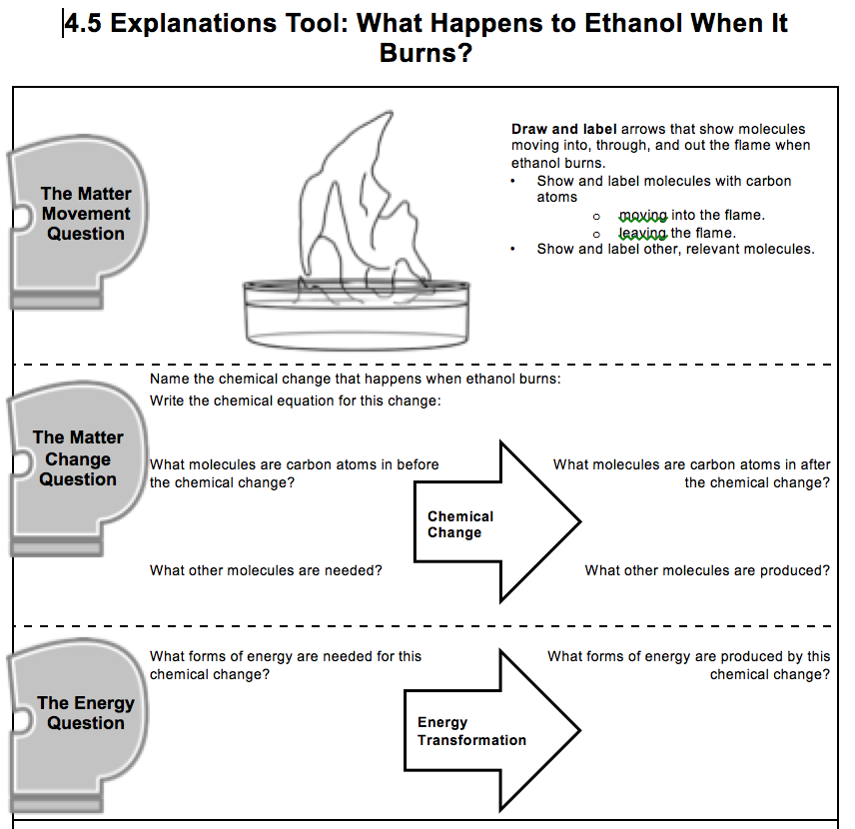
Constructing explanations
Consider the following as you construct your explanation:
Evidence from the investigation
What you learned from the molecular modeling activity
Three Questions Handout
Notes:
Have students complete the Explanations process tool.
Show slide 4 of the Grading the Explanations Tool for Ethanol Burning PPT. Give each student one copy of 4.5 Explanations Tool for Ethanol Burning.
Tell students that in this final step of the investigation, they will combine everything they learned about what happens when ethanol burns into one explanation.
Remind them to consider both their evidence from the investigation as well as what they learned in the molecular modeling activity to construct their explanations.
Give students about 10 minutes to complete the Explanations process tool.

Slide 5
Comparing Ideas with a Partner
Compare your explanations for each of the Three Questions.
How are they alike?
How are they different?
Check your explanation with the middle- and right-hand columns of the Three Questions handout.
Consider making revisions to your explanation based on your conversation with your partner.
Notes:
Have students share explanations with each other.
Show slide 5 of the Grading the Explanations Tool for Ethanol Burning PPT. Divide students into pairs and have them compare explanations for the Three Questions and the final explanation on the process tool.
Invite students to share their ideas with the class. Use the Three Questions Poster (or Handout) as a reference. Have students check their explanations with the middle and right-hand columns of the poster to make sure they are following the “rules.”

Slide 6
Matter Movement
Do you have:
An arrow showing ethanol evaporating and going into the flame
Ethanol
Notes:
Display slides 6-8 of the PPT. Have students compare their answers to the Matter Movement Question with the answers on the slide. Have students use a different colored writing utensil to make any needed changes to their answers. Allow students to ask questions if they do not understand why their ideas are incorrect.

Slide 7
Matter Movement
Do you have:
An arrow showing oxygen or O₂ entering the flame
O₂
Ethanol
Notes:
Display slides 6-8 of the PPT. Have students compare their answers to the Matter Movement Question with the answers on the slide. Have students use a different colored writing utensil to make any needed changes to their answers. Allow students to ask questions if they do not understand why their ideas are incorrect.

Slide 8
Matter Movement
Do you have:
An arrow showing carbon dioxide or CO₂ leaving the flame
An arrow showing water vapor or H₂O leaving the flame
H₂O
CO₂
O₂
Ethanol
Notes:
Display slides 6-8 of the PPT. Have students compare their answers to the Matter Movement Question with the answers on the slide. Have students use a different colored writing utensil to make any needed changes to their answers. Allow students to ask questions if they do not understand why their ideas are incorrect.

Slide 9
Matter Change
What is the name of the chemical change that happens when ethanol burns?
Combustion
Notes:
Display slide 9-10 of the PPT for the Matter Change Question and repeat the process above.

Slide 10
Matter Change
What molecules are carbon atoms in before the chemical change?
Ethanol or C₂H₅OH
What other molecules are needed?
Oxygen or O₂
Write the chemical equation for this change:
C₂H₅OH + 3 O₂ →
2 CO₂ + 3 H₂O
What molecules are carbon atoms in after the chemical change?
Carbon dioxide or CO₂
What other molecules are produced?
Water or H₂O
Chemical Change
Notes:
Display slide 9-10 of the PPT for the Matter Change Question and repeat the process above.

Slide 11
Energy Change
What forms of energy go into this chemical change?
Chemical energy or C-C and C-H bonds
What forms of energy come out of this chemical change?
Light and heat energy
Energy transformation
Notes:
Display slide 11 of the PPT for the Energy Change Question and repeat the process above.

Slide 12
Telling the Whole Story
Question: What happens to ethanol when it burns?
Does your story include these parts? (Check the back of the Three Questions Handout.)
Matter movement: Ethanol evaporating and going into the flame and oxygen going into the flame from the air.
Matter change: Ethanol reacting with oxygen to produce carbon dioxide and water.
Energy change: Chemical energy in ethanol being transformed into light and heat energy.
Matter movement: Carbon dioxide and water leaving the flame.
Notes:
(Optional) Have students critique example explanations
Display Slide 12 of the PPT. Have students look at two handouts: (a) the Three Questions Handout, and (b) the Systems and Scale Example Explanations Handout.
Ask students to evaluate the two example explanations of ethanol burning on the Systems and Scale Example Explanations Handout: Which explanation is better? Why?
Have students use the checklist on the back of the Three Questions Handout to justify their critiques of the explanations.
Have students critique and improve their full explanations.
Display slide 12 of the PPT for the full explanation. Have students use the checklist on the back of the Three Questions Handout to check that their story includes each of the parts (matter movement, matter change, energy change, and matter movement) and answers the prompt in a cohesive way.
If students don’t have all four parts in their explanation, instruct them to add to their explanation using a different colored writing utensil.
If students have model explanations to share, display student work and discuss. If students have common areas of weakness in their explanations, ask for a volunteer to share, display student work, and discuss ways of strengthening the response.
(Optional) Have student read about combustion and complete the graphic organizer.
Pass out 4.5 What Happens When Ethanol Burns? Reading. The reading provides a summary explanation of the combustion of ethanol and additional information about ethanol. Students can complete the reading individually or in pairs.
Students can also complete the 4.5 Matter & Energy in Ethanol Burning (Combustion) Graphic Organizer after reading if they need an additional review of the process.

Slide 13
How have your ideas changed?
Gather together your process tools for the unit (Expressing Ideas Tool, Predictions Tool, & Evidence-Based Argument Tool).
How have your ideas changed related to:
Scale?
Movement?
Carbon?
What do you know about ethanol now that you didn’t know before the investigation?
Notes:
Lead a discussion about how student ideas have changed over time.
Show slide 13 of the Grading the Explanations Tool for Ethanol Burning PPT. Have students look back over their process tools for this unit.
Have students consider how their ideas changed with regard to scale, movement, and carbon.
What do they know about ethanol burning now that they didn’t know before the investigation?

