Slide 1
Animals Unit Activity 5.1: Tracing the Processes of Cows Growing: Digestion and Biosynthesis
Carbon: Transformations in Matter and Energy
Environmental Literacy Project Michigan State University
Notes:
Image Credit: Craig Douglas, Michigan State University
Have students start to think about how cows grow.
Tell students that in today’s activity they will learn about how cows grow through digestion and biosynthesis.
Open 5.1 Tracing the Processes of Cows Growing: Digestion and Biosynthesis PPT.

Slide 2
Unit Map
You are here
Notes:
Use the instructional model to show students where they are in the course of the unit.
Show slide 2 of the 5.1 Tracing the Processes of Cows Growing: Digestion and Biosynthesis PPT. PPT.

Slide 3
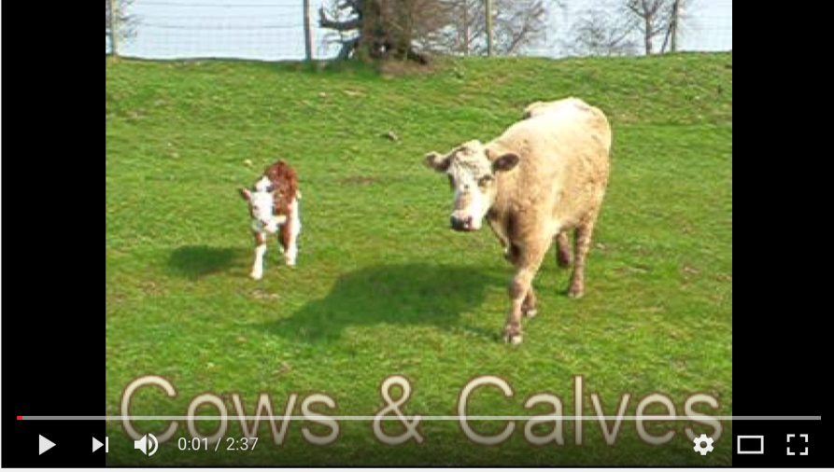
Connecting Questions about Processes at Different Scales: Digestion
Scale | Unanswered Questions
Macroscopic Scale | How do cows get food to all of their cells?
Microscopic Scale | How do food molecules get into a cow’s blood?
Atomic-Molecular Scale | How are molecules in food changed chemically so that a cow’s cells can use them?
Notes:
Image Credit (mealworms): FableVision
Image Credit (cow, baby): Craig Douglas, Michigan State University
Discuss Connecting Questions about Processes at Different Scales for Digestion
Display slide 3 in the PPT. Show students the short clip of a cow growing. Follow the link in the PPT, in the materials list, or here (https://www.youtube.com/watch?v=LWJN7li120c). You can opt to only play thirty seconds.
Introduce students to the macroscopic driving question: How do cows get food to all of their cells?
Connect this question at the macroscopic scale to an unanswered question at the microscopic scale: How do food molecules get into a cow’s blood?
Connect this question at the microscopic scale to an unanswered question at the atomic-molecular scale: How are molecules in food changed chemically so that a cow's cells can use them?
Assure students that we will be able to answer several of their unanswered questions by the end of today’s activity.

Slide 4
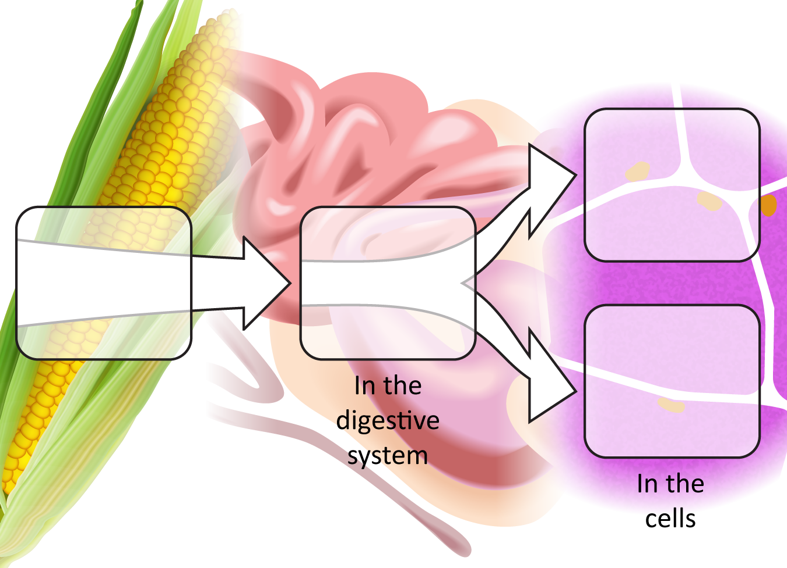
What happens to the food cows eat?
Food
Digestion
Energy: Cellular respiration
Notes:
Image Credit: Craig Douglas, Michigan State University
Have students think about what happens to the food cows eat (digestion).
Display Slide 4 to show students that animals use digested food in two ways. Tell students they have learned about one of those uses (cellular respiration). Today they’ll be focusing on what happens to the food cows eat before the food molecules are used for cellular respiration, digestion, and later in the lesson the second way that animals’ use digested food.
Display Slide 5 to introduce the parts of a cow, focusing on the stomach, intestines, and leg muscle.
Give each pair of students a Cow 11 x 17 Poster, a copy of 5.1 Tracing the Process for Cow Growing: Digestion and Biosynthesis Directions (you may want to give each student a copy of these directions), 2 nickels, and 5 pennies.
Explain that they will follow the directions to use their nickels and pennies to trace the path of food in the cow.
Tell students to pause at the end of the first page.

Slide 5
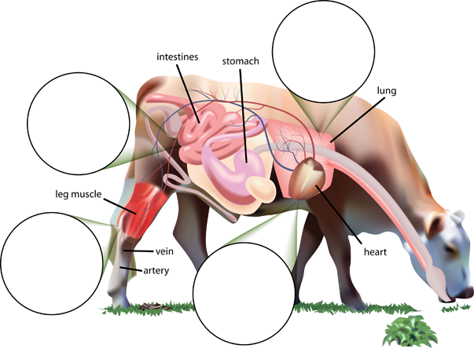
Notes:
Image Credit: Craig Douglas, Michigan State University
Display Slide 5 to introduce the parts of a cow, focusing on the stomach, intestines, and leg muscle.
Give each pair of students a Cow 11 x 17 Poster, a copy of 5.1 Tracing the Process for Cow Growing: Digestion and Biosynthesis Directions (you may want to give each student a copy of these directions), 2 nickels, and 5 pennies.
Explain that they will follow the directions to use their nickels and pennies to trace the path of food in the cow.
Tell students to pause at the end of the first page.

Slide 6
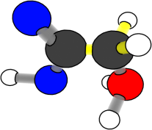
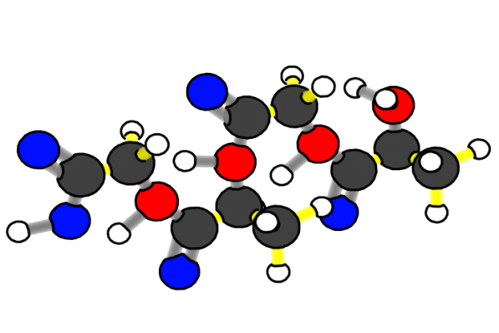
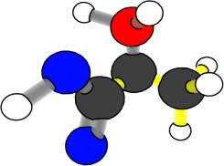
What happens to carbon atoms and chemical energy in digestion?
Chemical change
Large organic molecules (+ water)
Small organic molecules
Reactants
Products
Notes:
Image Credit: Craig Douglas, Michigan State University
Show the animation of digestion.
Display slides 6 and 7 when all pairs have finished the first page of directions.
Show students the animation of digestion so they can see what happens to carbon atoms and energy during the process.
When watching the slides, ask students what is happening to energy. Listen to see if they notice that chemical potential energy is conserved in the C-C- and C-H bonds through digestion.
Show students the Digestion and Biosynthesis 11 X 17 Posters to help students visualize the process.

Slide 7
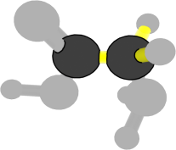
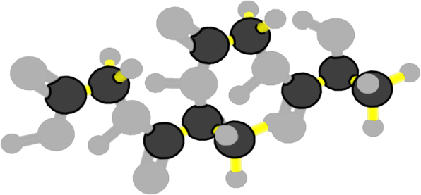
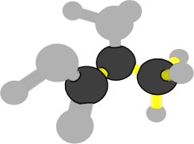
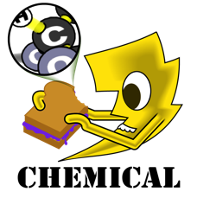
What happens to carbon atoms and chemical energy in digestion?
Chemical change
Carbon atoms stay in organic molecules with high-energy bonds
Large organic
molecules (+ water)
Small organic molecules
Reactants
Products
Notes:
Image Credit: Craig Douglas, Michigan State University
Show the animation of digestion.
Display slides 6 and 7 when all pairs have finished the first page of directions.
Show students the animation of digestion so they can see what happens to carbon atoms and energy during the process.
When watching the slides, ask students what is happening to energy. Listen to see if they notice that chemical potential energy is conserved in the C-C- and C-H bonds through digestion.
Show students the Digestion and Biosynthesis 11 X 17 Posters to help students visualize the process.
Have students trace steps 4-6 on the cow poster.
Tell students to continue following the directions on 5.1 Tracing the Process for Cow Growing: Digestion and Biosynthesis Directions and pause when they finish step 6.

Slide 8
Connecting Questions about Processes at Different Scales: Biosynthesis
Scale | Unanswered Questions
Macroscopic Scale | How do cows grow?
Microscopic Scale | How do cows’ cells use small organic molecules to grow?
Atomic-Molecular Scale | How do cells make their large organic molecules?
Notes:
Transition students to talk about biosynthesis.
Use slides 8 and 9 in the PPT to transition to biosynthesis.
Tell students that cells use digested food for cellular respiration (that they explained in Activity 4.2) and also for growth, which is done through a process called biosynthesis.
Have students finish the directions on 5.1 Tracing the Process for Cow Growing: Digestion and Biosynthesis Directions to trace biosynthesis.
Note: biosynthesis occurs in all cells, but here muscle cells are an example.

Slide 9
How do cows’ cells use food to grow?
Materials for growth: Biosynthesis
Food
Digestion
Energy: Cellular respiration
Notes:
Image Credit: Craig Douglas, Michigan State University
Transition students to talk about biosynthesis.
Use slides 8 and 9 in the PPT to transition to biosynthesis.
Tell students that cells use digested food for cellular respiration (that they explained in Activity 4.2) and also for growth, which is done through a process called biosynthesis.
Have students finish the directions on 5.1 Tracing the Process for Cow Growing: Digestion and Biosynthesis Directions to trace biosynthesis.
Note: biosynthesis occurs in all cells, but here muscle cells are an example.

Slide 10
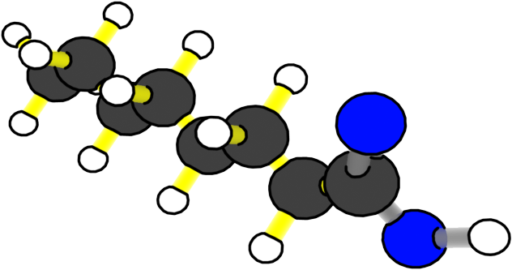
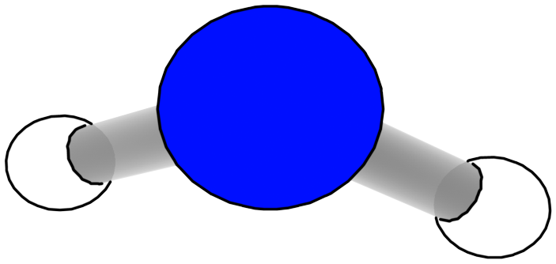
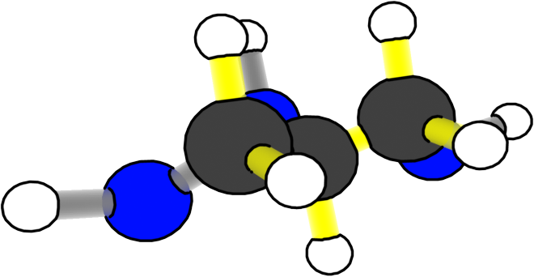
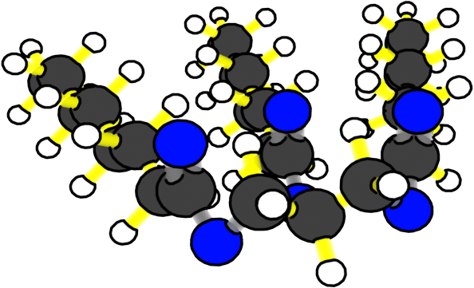
What happens to carbon atoms and chemical energy in biosynthesis?
Chemical change
Fatty acids + glycerol
Fat (+ water)
Reactants
Products
Notes:
Image Credit: Craig Douglas, Michigan State University
Show an animation of the process of biosynthesis.
Display slide 10-11 to show an animation of what happens to the molecules and chemical energy during biosynthesis.
When watching the slides, ask students what is happening to energy. Listen to see if they notice that chemical potential energy is conserved in the C-C- and C-H bonds through biosynthesis.
Show students the Digestion and Biosynthesis 11 X 17 Posters to help students visualize the process.

Slide 11
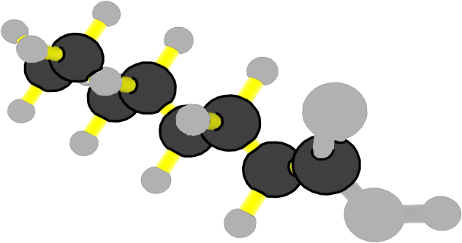
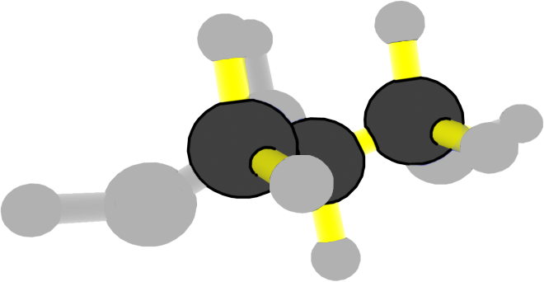
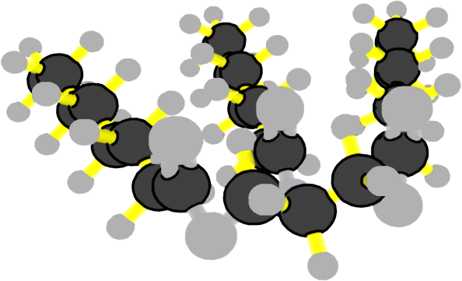
What happens to carbon atoms and chemical energy in biosynthesis?
Chemical change
Carbon atoms stay in organic molecules with high-energy bonds
Fatty acids + glycerol
Fat (+ water)
Reactants
Products
Notes:
Image Credit: Craig Douglas, Michigan State University
Show an animation of the process of biosynthesis.
Display slide 10-11 to show an animation of what happens to the molecules and chemical energy during biosynthesis.
When watching the slides, ask students what is happening to energy. Listen to see if they notice that chemical potential energy is conserved in the C-C- and C-H bonds through biosynthesis.
Show students the Digestion and Biosynthesis 11 X 17 Posters to help students visualize the process.

Slide 12
How do animal cells use glucose?
The diets of most animals—including mealworms, cows, and humans—include lots of carbohydrates (starch, fiber, sugar)
This means that lots of glucose travels to animal cells in the blood.
BUT animal cells don’t make starch or cellulose.
How do they use the glucose?
Notes:
Discuss how animal cells use sugar molecules.
Use slides 12 and 13 to discuss how animal cells use sugar molecules.
Use slide 12 to point out the problem: Lots of sugar molecules reach animal cells, but they are not made into starch or fiber polymers in animal cells.
Use slide 13 to explain the two main ways that animals use sugar molecules: (a) they are used to make glycerol and fatty acids and eventually fat (this explains why eating lots of starch and sugar can make someone gain weight), and (b) they are used for cellular respiration, which uses sugar and oxygen to release energy.

Slide 13
Animal cells use glucose in two ways
Animal cells can combine glucose molecules with oxygen to release chemical energy in cellular respiration.
This is how all cells get the energy they need for their functions.
Animal cells can make fat molecules from glucose molecules.
Glycerol and fatty acids are made of the same atoms—C, H, and O—as glucose molecules
Animals use fats to store chemical energy in C-C and C-H bonds
Notes:
Discuss how animal cells use sugar molecules.
Use slides 12 and 13 to discuss how animal cells use sugar molecules.
Use slide 12 to point out the problem: Lots of sugar molecules reach animal cells, but they are not made into starch or fiber polymers in animal cells.
Use slide 13 to explain the two main ways that animals use sugar molecules: (a) they are used to make glycerol and fatty acids and eventually fat (this explains why eating lots of starch and sugar can make someone gain weight), and (b) they are used for cellular respiration, which uses sugar and oxygen to release energy.

Slide 14
Where do the atoms in animals come from?
Work with a partner to complete the first chart about atoms.
Notes:
Transition to have students consider the atoms that make up animals.
Show slide 24 of the PPT. Pass out 5.1 Tracing the Atoms and Energy in Animals Worksheet to each student.
Tell students that now they have considered how molecules move through and are used by a cow they will now consider the atoms that make up animals.
Read the top portions of the worksheet with students.
Have students work with a partner to complete the first chart on the worksheet about atoms.

Slide 15
Remembering Nutrition Labels
Animal cells are made of:
Water: around 60% (H₂O)
Large organic molecules: less than 40%
Fats: Made of C, H, and O atoms
Proteins: Made of C, H, O, and N atoms
(Some other large organic molecules such as DNA, made from C, H, O, N, and P atoms)
Minerals: around 1%
Many kinds of atoms including sodium, and calcium, magnesium
Notes:
Have students identify where the atoms that make up animals come from.
Show slide 15 of the PPT.
Remind students that in Lesson 2 they learned about the molecules that make up cells and the atoms that make up the molecules.
Discuss the answers to the first chart on the worksheet. The atoms in the large organic molecules of animals all primarily come from food. Water and air are used during cellular respiration.

Slide 16
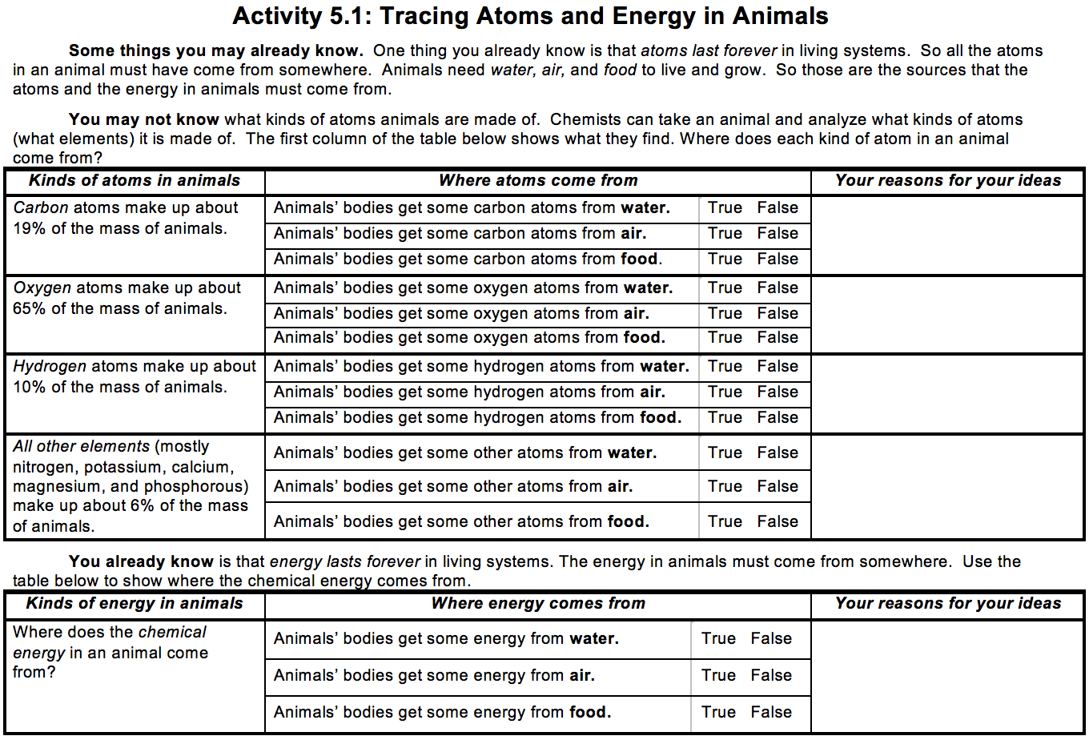
Where does the energy in animals come from?
Work with a partner to complete the second chart about energy.
Notes:
Have students identify where the energy in animals come from.
Show slide 16 of the PPT.
Have students complete the second chart on 5.1 Tracing the Atoms and Energy in Animals Worksheet on energy with a partner.
Show slide 17. Remind students that chemical energy is in C-C and C-H bonds.
Discuss students’ answers together. Chemical energy is only found in the food that animals take in. There is no chemical energy in the water or air animals take in.

Slide 17
Chemical Energy
Chemical energy is stored in C-C and C-H bonds.
Does water have chemical energy?
Does air have chemical energy?
Does food have chemical energy?
Notes:
Show slide 17. Remind students that chemical energy is in C-C and C-H bonds.
Discuss students’ answers together. Chemical energy is only found in the food that animals take in. There is no chemical energy in the water or air animals take in.

Slide 18
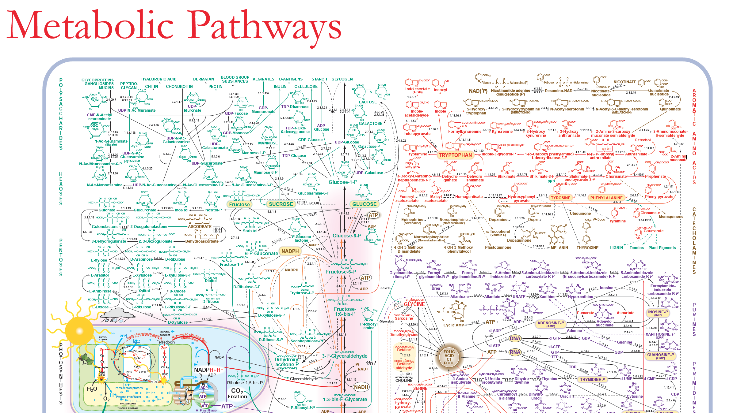
Additional Metabolic Pathways
There are many more small organic molecules and ways they can be changed other than the ones in this lesson. Look at the Metabolic Pathways poster to see some of them.
Notes:
Show students that there are many additional metabolic pathways.
Use slide 18 and the Metabolic Pathways 11 x 17 Poster to show students that there are many more metabolic pathways besides what they learned about in this lesson.
This poster only shows pathways in which small organic molecules are changed into other small organic molecules. There are other pathways that change small organic molecules into large organic molecules.
Explain that these processes allow cows who eat mostly carbohydrates in grass to be made up of protein and fat.
Organisms are complex; this poster also offers students a glimpse of their complexity.

