Slide 1
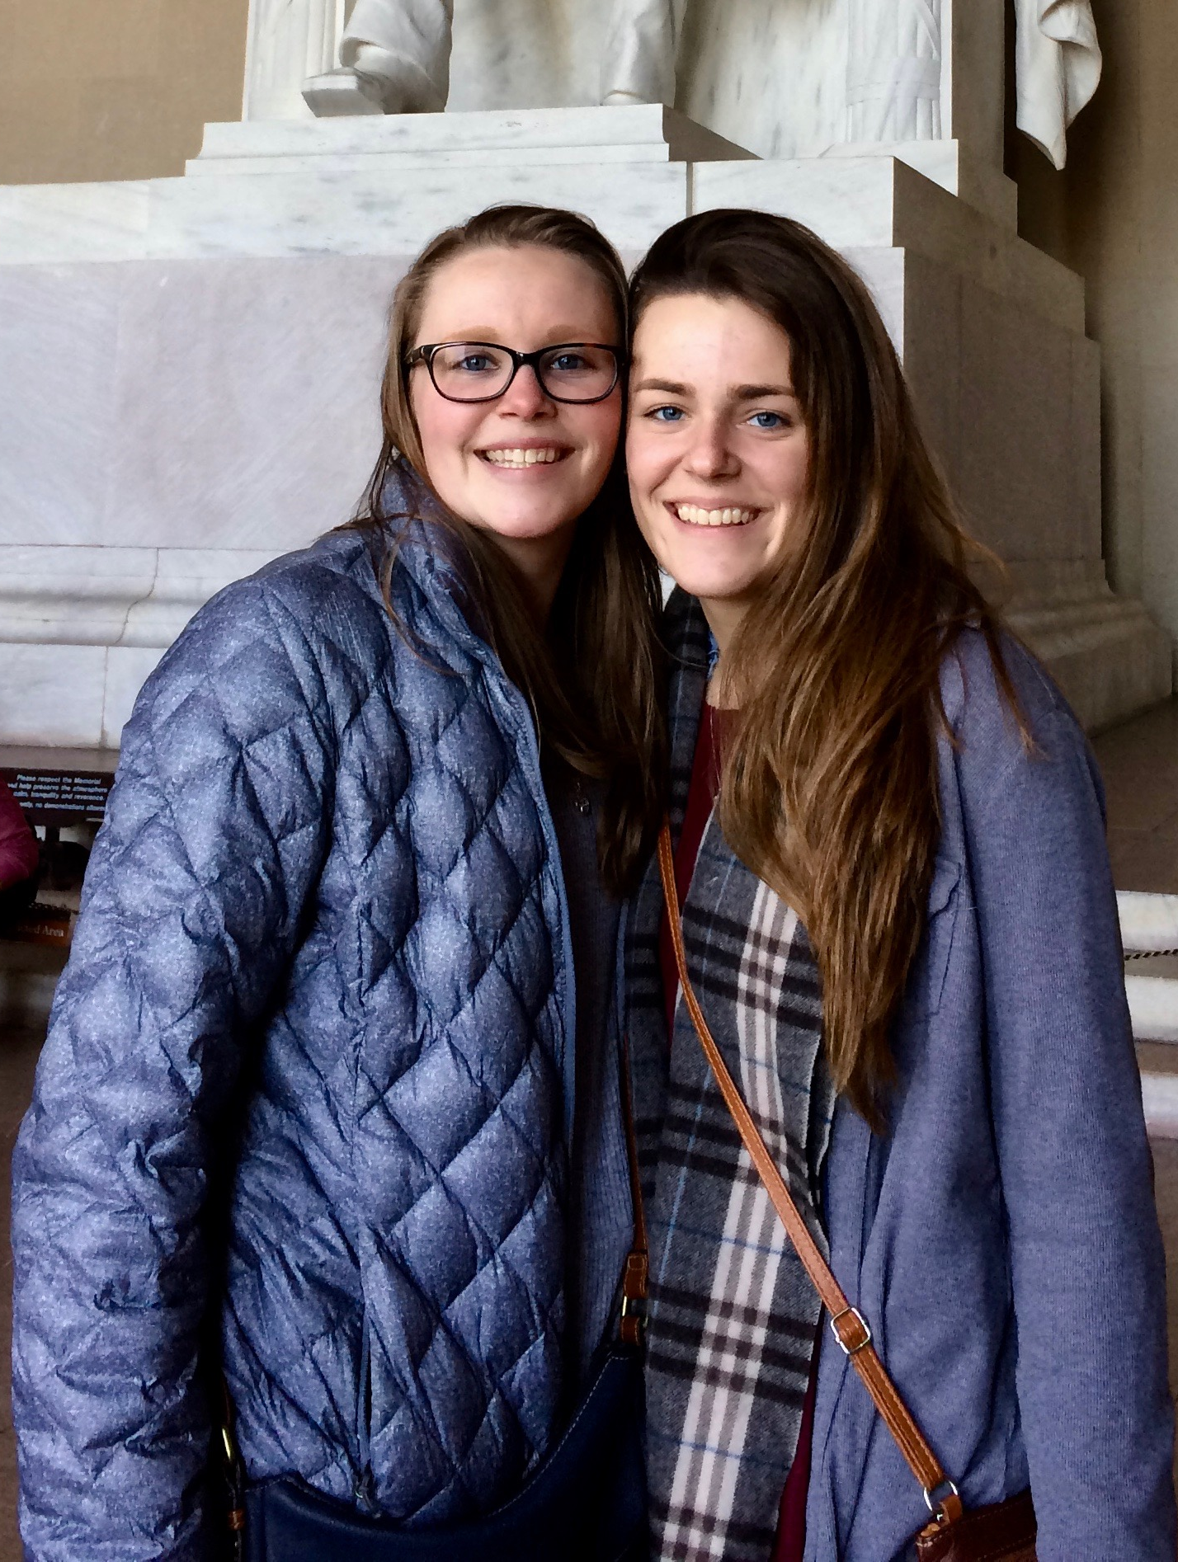
Case 1: Twins
Me and my sister, Sam, are fraternal twins. We look alike and share many characteristics; we both love to play basketball and soccer, enjoy biology and the sciences, listen to similar music and have many mutual friends. Scientists think that similarities between closely related people are…
Almost entirely a result of sharing the same genes.
Almost entirely a result of sharing similar experiences.
Partly a result of the same genes and partly a result of similar experiences.
Neither the result of sharing the same genes nor having similar experiences.
Almost entirely a result of random chance factors.

Slide 2
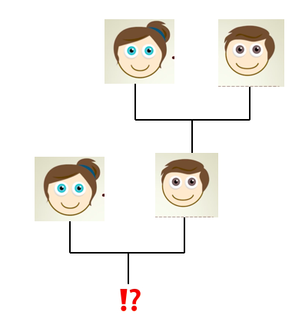
Case 2: Eye Color
Molly and Steve are going to have a baby and are predicting what color eyes their child will have. Molly has blue eyes and Steve has brown eyes but Steve’s mom also has blue eyes. What color eyes do you think their baby will have?
It will depend on what gender the baby is; a female will have blue eyes and a male will have brown eyes.
The baby will definitely have brown eyes because it will always get a dominant brown allele from Steve.
The baby could have either blue or brown eyes depending on which alleles it gets from Molly and Steve.
The baby could have either blue or brown eyes depending on the environment in which the baby is born in.

Slide 3
Case 3: Blood Type
Sarah is trying to figure out the paternity of her child. Sarah has blood type O (ii) and her baby has blood type A. Who could the father be? (there may be more than one answer)
Scott – type B (Bi)
Henry – type A (AA)
Rick – type AB (AB)
Patrick – type O (ii)
All of the above
None of the above

Slide 4
2nd hour
Case 1 | Case 2 | Case 3
A 0 | A 0 | a. 0
B 8 Genes don’t determine what you like, but what you experience influence what you like | B 7 Dad is the dominant trait and the female is the recessive, and the is mostly likely to show My family- Bella Grandparents influence the grandkids | b. 12 A capital (A) mean since parent is AA must give A to child Child will have a recessive allele too (Ai)
C 15 Similar looks genetic Sports and music experience Fraternal twin are like siblings born at the same time Parents share similar traits | C 16 Two parents can have brown because its dominant and have a kid with blue eyes Steve’s mom has blue eyes so he has to have an allele for blue eyes (Bb) x (bb) How does a mix of colors in parents (blue x brown)make new colors in kids (green & blue/ brown) Mom and uncle green- their kids are brown, but grandkids are green Punnett squares from 7th grade | C 7 50 % chance that he will give (A) or (B)
D 0 | D 0 | D 2 dominant trait theory
E 0

Slide 5
3rd Hour
Case 1 | Case 2 | Case 3
A 0 | A 0 | A 1 he can give the little ‘I’ to everyone
B 0 | B the brown eye color is dominant, you can only have a blue eyed offspring if both parents have blue eyes | B 20 A is a dominant allele, if you pass down the A, the kid will be A. the kid gets a ‘I’ recessive allele from the mom
C 17 look alike is genes, interest are sharing similar experiences Being closely related has a science aspect and a social aspect Similar genes make it easier for us to do the same things | C 21 Steve has the recessive blue allele The baby definitely gets the blue allele from mom, and has 50/50 to get brown or blue from dad Parents that are brown and blue, blue kid Parents that are blue and brown, kids with blue and brown eyes Parents with green and blue, kid with blue but change to greenish Eyes started blue, turned brown, now turning hazel How do people have two different colored eyes? Does melanin color eyes? What is our default eye color? | C 6 Rick has the A and B allele and he could pass on the A allele If he passes on the A allele, the baby has to be type A. If he passes on the B allele, the baby will be type B. No baby can be type O
D 0 | D 0 | D 2
E 2 Mark and his twin are nothing alike |  | Can blood type change?

Slide 6
5th Hour
Case 1 | Case 2 | Case 3
A 0 | A 0 | A 0
B 0 | B 0,1 it could be if they have a certain trait that is only passed on to males (related to color blindness) | B 15 for a child to have blood type A, one parent needs to be A Henry has to pass on an A
C 25 physical traits caused by genes, psychological (personality, opinions, views) from experiences Physical traits from environment too | C 21 the mother is going to pass on a recessive blue allele, the dad has a 50% chance of passing on blue, and a 50% change of passing on brown 75% brown, 25% blue (depends on dads second allele) | C 2 for the kid to be A, rick needs to pass on his A 50% chance for rick to pass on an A
D 0 | D 0 | D 0
E 1 not all twins are alike and similar experiences don’t lead to the same people | Blue or brown, but more likely to have brown because blue is recessive
Physical similarities caused by genes, psychological and preferences determined by experience | We don’t have enough information to answer the question. We need Molly’s mom and dad’s eye color to determine.

